Slide 1


GovHack 2025:
Australia's AI Future -
A Data-Driven Framework for Data Center Siting
Chung-Hao Lee
Aug 31, 2025
Notes:
Hello Everyone,
My name is Chung-Hao Lee. I just relocated from Taiwan to Sydney. I am now working at TikTok as a PM. You can find my information in the last page of the report.
I’d like to thank you GovHack first for hosting this fabulous hackathon. I would definitely recommend to all who love data analysis to join this hackathon.

Slide 2
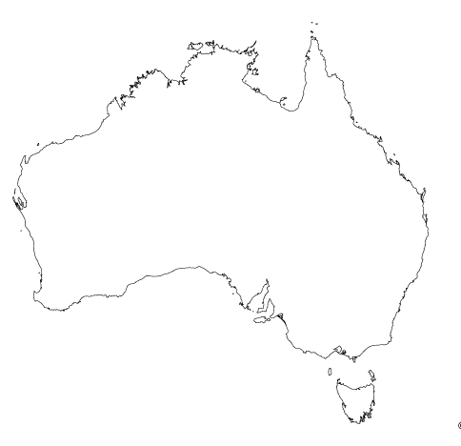


The Challenge:
Data Centers: A Cornerstone of Australia's AI Future
With AI driving exponential data growth, data centers are now essential. With abundant resources, reliable power supply, skilled workforce, and strategic location between East Asia and USA, Australia is exceptionally well positioned to become a leading data center hub.
Despite Australia’s strong fundamentals for data-center growth, currently there is no standard framework to evaluate optimal siting for data center.
This report proposes a data-based evaluation framework uses it to identify the regions most suited for data-center development.
Notes:
In this hackathon, I chose challenge of data center siting.
This challenge is about Australia holds a great position to develop international data center hub, because abundant resource, skilled workers and great strategic position between East Asia and American, two most data generation areas.
But right now, there is no a framework to help Australia stakeholder to evaluate where to pick a great siting for data center.
Thus, That what I do in this report

Slide 3
The Framework:
Five Major Factors to Select Suitable Locations
Power Availability & Reliability
Data centers rely on massive power consumption, making energy availability and grid stability critical determinants in site selection.
Cooling & Thermal Management
Data centers generate substantial waste heat, making cooling capacity a critical siting factor, particularly in regions with access to water resources or naturally cooler climates.
Connectivity
Data centers rely on large-scale data transmission, and heavy data flows from East Asia and the U.S. make proximity to submarine cables a key siting factor.
Talent & Labor Force
Data centers require skilled professionals such as network and server engineers to ensure reliable operations, making access to talent a key siting factor.
Land & Infrastructure
Data centers require large land parcels and reliable infrastructure, including power, water, and fire protection, making regions with low-cost land and strong utilities a critical siting factor.
Notes:
In this report, I propose a framework with 5 major factors to evaluate where to place data center, there are Power Availability & Reliability Cooling & Thermal Management Connectivity Talent & Labor Force Land & Infrastructure
In the following session, I will briefly walk you through each factor and see where in Australia is a good fit

Slide 4
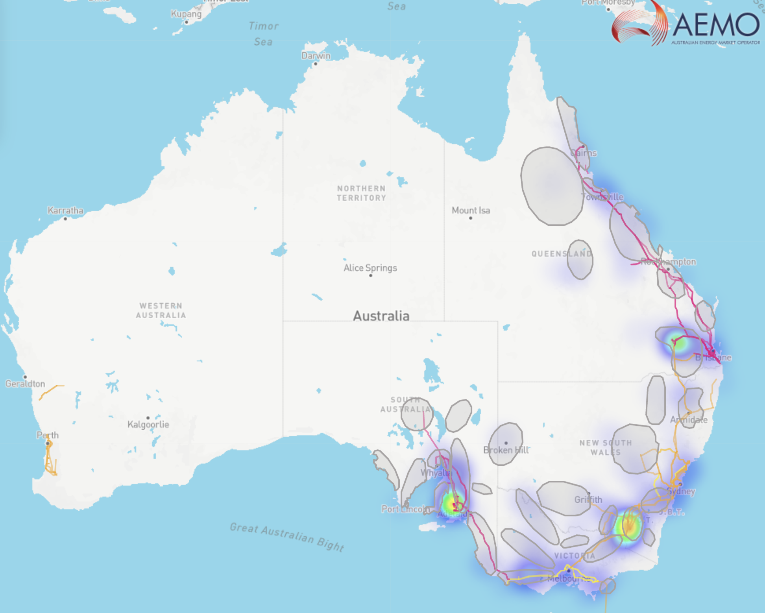
The Factor One:
Power Availability & Reliability
Regions with Current & Future Clean Power Supply:
Brisbane, ACT, Adelaide
Regions with Future Clean Power Potential:
Melbourne, Armidale
The operation of a large data center can require millions of kWh each month. Therefore, regions with abundant power supply, grid stability, and access to low-carbon energy make energy availability a decisive factor in site selection.
AEMO geospatial data highlights regions where grid stability, current clean-energy availability, and future potential.
Brisbane
Adelaide
ACT
Figure: Map of Australia’s clean energy landscape. Coloured regions indicate current supply density, with deeper red representing higher energy availability. Grey circles highlight areas with strong future clean-energy potential. Grid connectivity is shown with transmission lines: yellow (500 kV), orange (330 kV), and red (275 kV). Clean-energy sources include wind, solar, hydro, and gas.
Source: Australian Energy Market Operator Grid Data
Notes:
First is Power Availability & Reliability.
Because The operation of a large data center can require millions of kWh each month. Therefore, regions with abundant power supply, grid stability, and access to low-carbon energy make energy availability a decisive factor in site selection. I chose AEMO geospatial data to visualize current power supply across Australia. As you can see in the figure, Brisbane, ACT are regions with great clean energy supply now and in the future. While Melbourne holds great potential in the future.

Slide 5
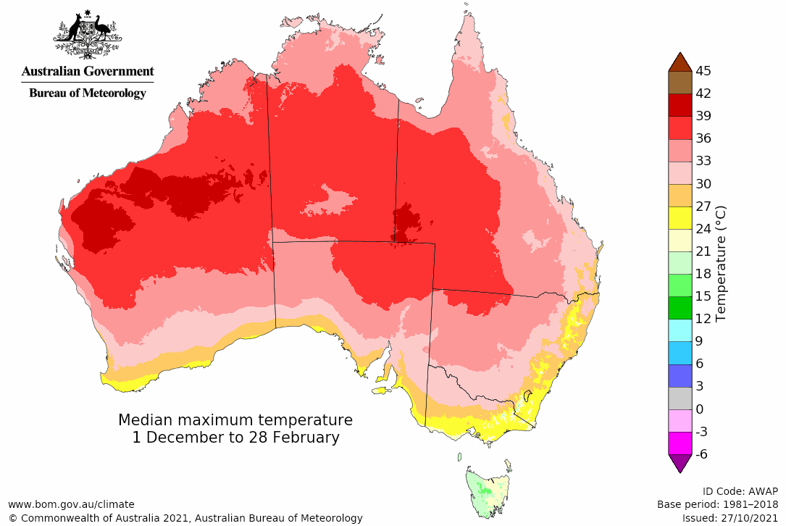
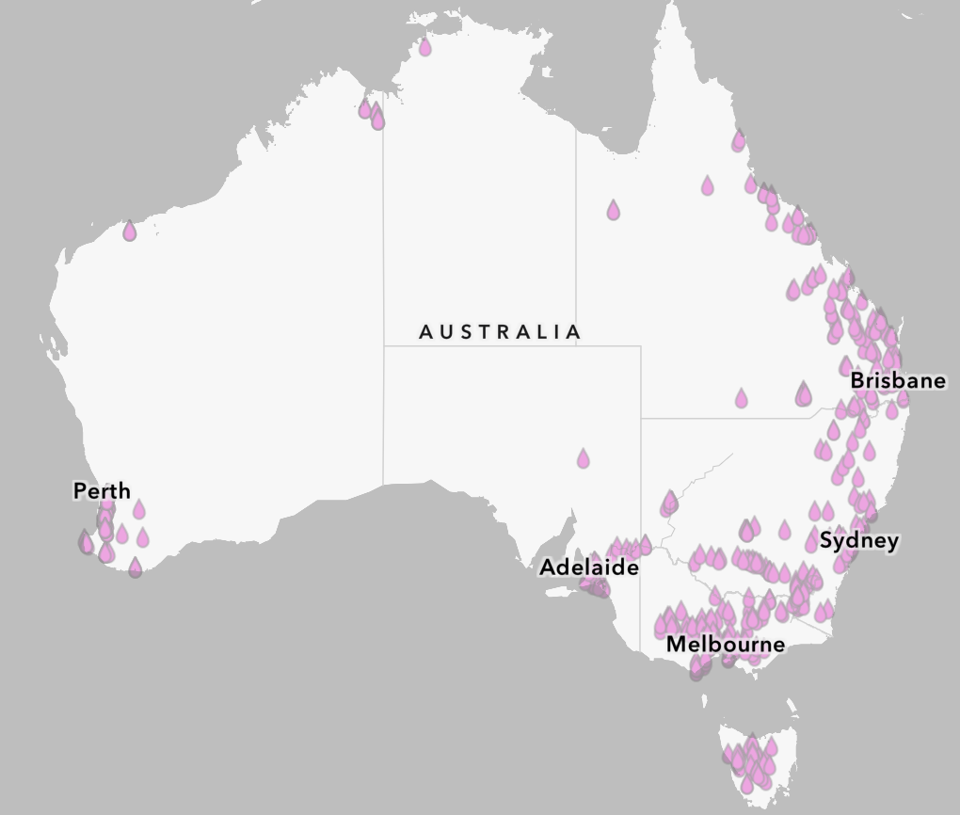
The Factor Two:
Cooling & Thermal Management - Temperature & Water
Regions with Moderate Temperature & Reliable Water Supply:
ACT, Melbourne, Sydney, Brisbane
Data centers produce waste heat, thus effective cooling is critical.
While both air and liquid cooling are used, liquid cooling offers higher efficiency. As a result, ideal sites are regions with moderate temperatures and reliable water supply.
Based on Australia’s summer median maximum temperature and water storage distribution, the southeastern coastal urban regions are most favourable.
Figure: (Upper) Median maximum temperatures in Australia during summer (Dec–Feb), with deeper red indicating higher temperatures.
(Lower) Distribution of water storage volume across Australia, where denser clusters of purple droplets represent greater water availability.
Source:
Australia Bureau of Meteorology
Digital Atlas of Australia
Notes:
Second is Cooling & Thermal Management
Because Data centers produce waste heat, thus effective cooling is critical.
I choose data from Australia Bureau of Meteorology, Digital Atlas. To check temperature and water availability, which are effective cooling methods.
ACT, Melbourne, Sydney, Brisbane are regions with moderate temp and have Reliable Water Supply

Slide 6
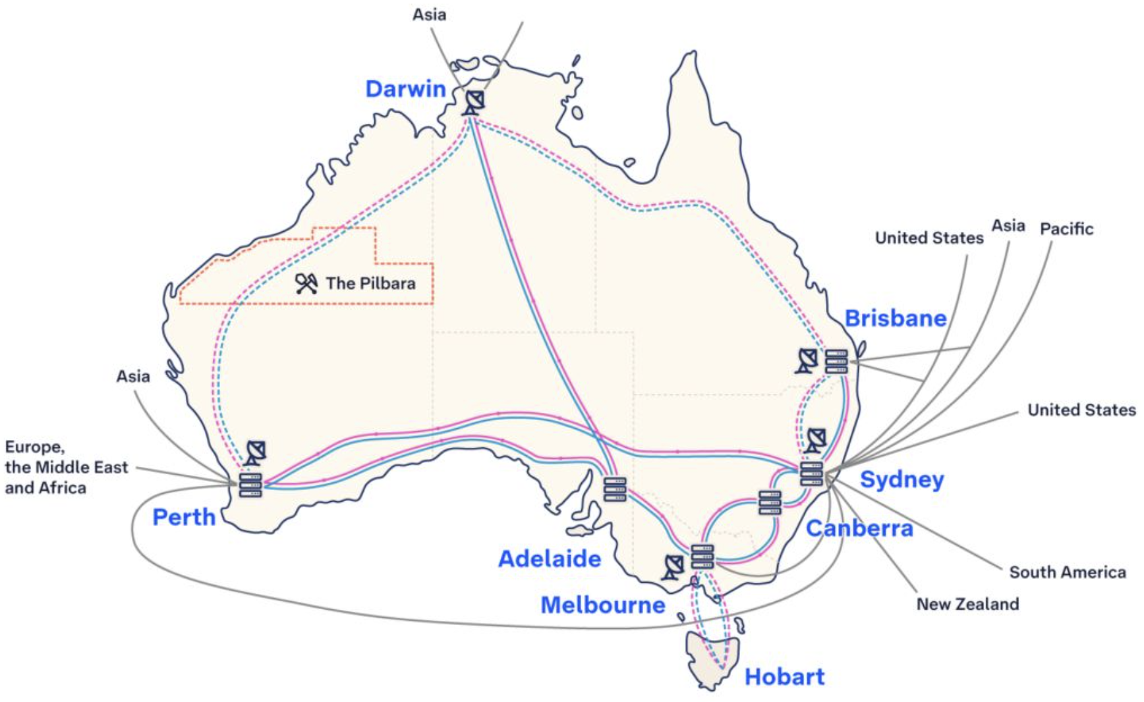
The Factor Three:
Connectivity - Submarine Cable & Intercity Fiber Network
Regions near submarine cable landing point & Major city:
Sydney, Brisbane, Perth
Regions with great potential:
ACT, Melbourne
As AI booming, vast volumes of data need storage and processing. Australia’s strategic location between the world’s two largest data-producing areas, East Asia and the United States makes it ideal for data-center development.
Massive data flows rely on cable connections, so proximity to submarine cable landing points and major domestic city data hubs is crucial to reduce latency and costs.
Figure: Map of Australia’s submarine cable and intercity fiber network connectivity, showing landing points of submarine cables and the fiber network links between major Australian cities.
Source: Intercity Fiber Network
Notes:
Third is connectivity,
If Australia want to be an international data center hub, it has to find a near submarine cable place to build data center.
Data from Telstra shows current Australia submarine cable map and intercity fiber network.
Sydney, Brisbane, Perth are regions near submarine cable landing point, and ACT, Melbourne with great potential

Slide 7
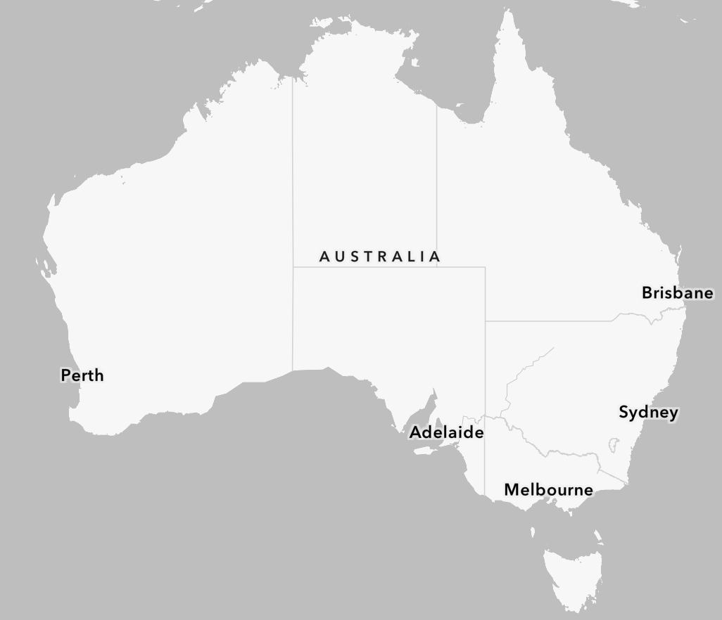
The Factor Four:
Talent & Labor Force
Regions near submarine cable landing point & Major city:
Sydney, Melbourne, Brisbane, ACT
Data center operations need diverse tech talent (electricians, network and server engineers, equipment engineers…etc.), so proximity to talent hubs is essential.
Tech Council 2023 data shows Queensland, NSW, ACT and Victoria have strong current workforces and good growth potential; these states also host leading universities that feed the talent pipeline.
70,000 (1%)
Growth +98%
140,000 (15%)
Growth +49%
71,000 (8%)
Growth +41%
44,000 (5%)
Growth +27%
332,000 (35%)
Growth +58%
ACT
43,000 (5%)
Growth +61%
287,000 (31%)
Growth +63%
Figure: Distribution of tech workforce across Australian states in 2023, showing headcount by state and annotated growth rates.
Source: Tech job update by TechCouncil of Australia
Notes:
orth is Talent & Labor Force
Data center operations need diverse tech talent so proximity to talent hubs is essential.
Data from ABS and tech council shows that Sydney, Melbourne, Brisbane, ACT all have abundant and diverse talents and have high growth rate.

Slide 8
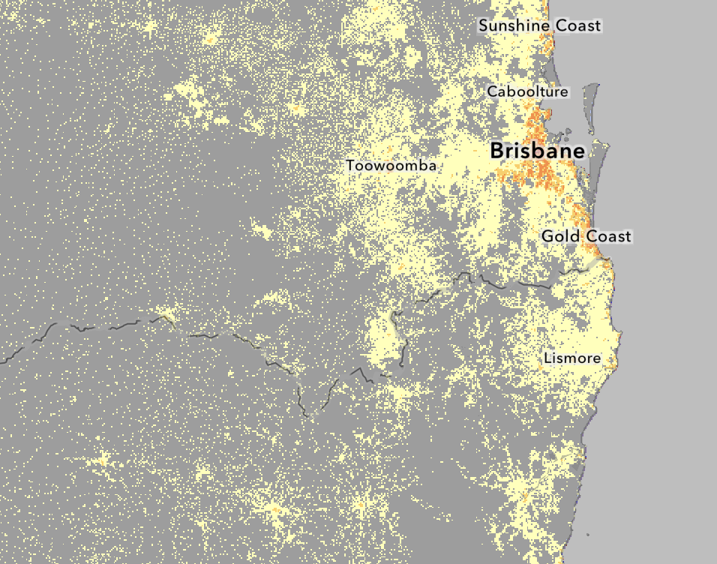
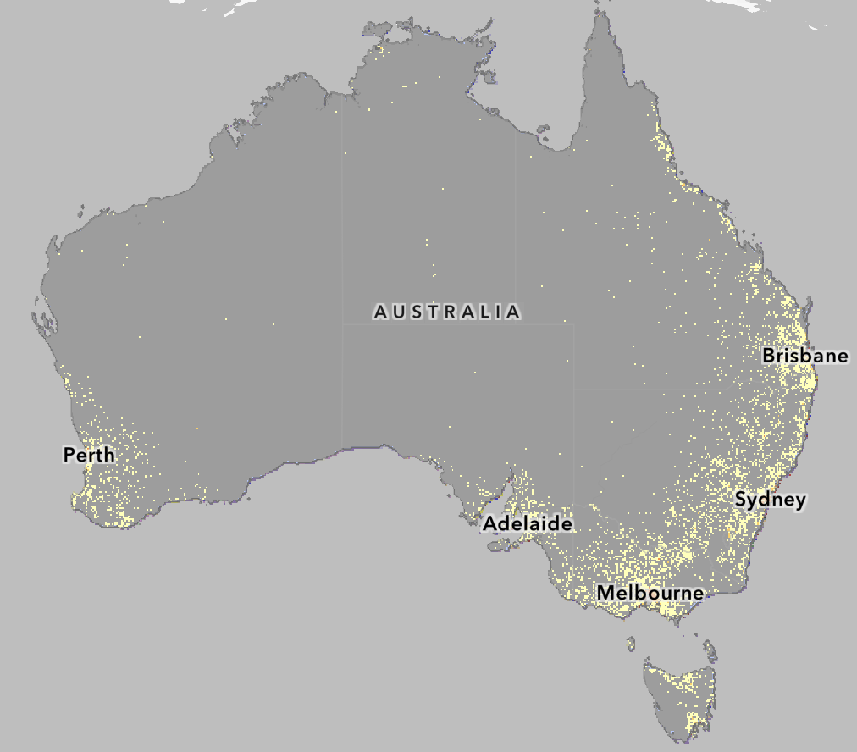
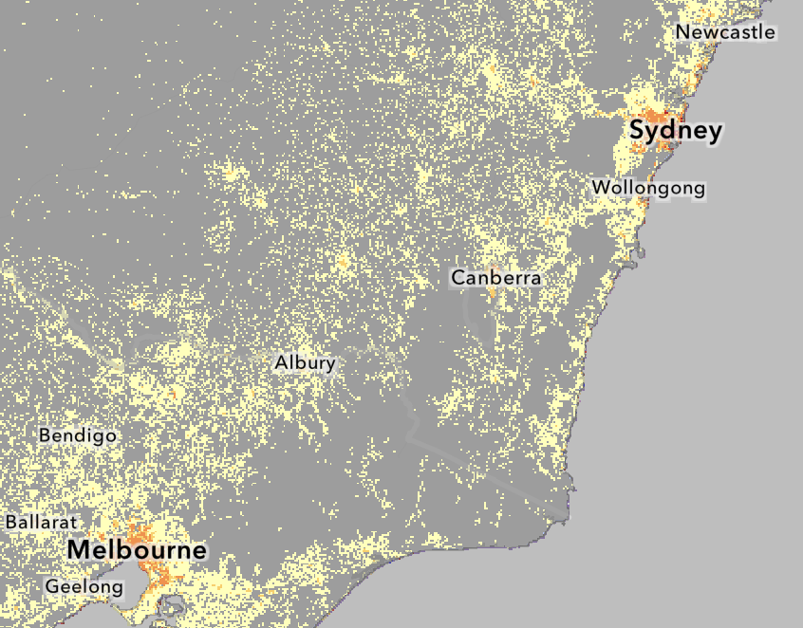
The Factor Five:
Land & Infrastructure
Regions (Suburban Zones) with moderate populate density:
Brisbane, ACT, Melbourne, Sydney, Perth
Data centers need large, low-cost land, mature utilities (power, water, fire protection) and low disaster exposure.
Because dense urban areas have strong infrastructure but high land prices, and very sparse areas lack utilities, population density is an effective proxy to find the sweet spot: suburban zones with moderate density close to cities.
Applying this rule identifies outer Brisbane and the Sydney→ACT→Melbourne suburban corridor as the most suitable areas.
Figure: ABS 2024 map of population distribution across Australia; brighter, denser areas indicate higher population concentration.
Source: Digital Atlas of Australia
Notes:
Last but not least Land and infrastructure
Data centers need large, low-cost land, mature utilities (power, water, fire protection) and low disaster exposure.
I chose data from digital atlas to show population density
Because dense urban areas have strong infrastructure but high land prices, and very sparse areas lack utilities, population density is an effective proxy to find the sweet spot: suburban zones with moderate density close to cities.
Brisbane, ACT, Melbourne, Sydney, Perth all fit this criteria

Slide 9

The Summary:
Brisbane & ACT are current top locations,
Sydney & Melbourne hold high future potential.
 | Power Availability & Reliability | Cooling & Thermal Management | Connectivity | Talent & Labor Force | Land & Infrastructure | Total Score
Brisbane | 1 | 1 | 1 | 1 | 1 | 5
ACT | 1 | 1 | 0.5 | 1 | 1 | 4.5
Sydney | 0 | 1 | 1 | 1 | 1 | 4
Melbourne | 0.5 | 1 | 0.5 | 1 | 1 | 4
Perth | 0 | 0 | 1 | 0.5 | 1 | 2.5
Factor
Region
Under the framework, each region is scored across five factors: assign 1 point if the region meets the criterion currently and 0.5 points if it shows future potential; a region’s overall score is the sum across all five factors.
Based on the five-factor scores, Brisbane and the ACT rank as the most suitable regions for immediate data center development, with Sydney and Melbourne closely following.
Source: Digital Atlas of Australia
Notes:
Under the framework, each region is scored across five factors: 1 point if the region meets the current criterion and 0.5 points if it shows future potential
Overall Brisbane scores highest score to be the region develop international data center hub. Closely follow by ACT. And Sydney, Melbourne with great potential

Slide 10
The Summary:
Summary & Future Work
Purpose: Provide a practical Data Center site-selection framework to support development of international-grade data centers in Australia.
Framework: Assess regions using five core factors — Power Availability & Reliability; Cooling & Thermal Management; Connectivity; Talent & Labour Force; and Land & Infrastructure.
Approach & scope: Applied the framework as a high-level, nationwide screening across Australia’s major regions to identify suitable large-scale locations.
Key finding: Brisbane and the ACT score highest for immediate development; Sydney and Melbourne are close behind.
Limitations: Analysis was completed within a single weekend and therefore produces a regional-level shortlist rather than detailed site recommendations.
Future work / recommendations:
Introduce weighted scoring for the five factors to reflect real-world priorities and investor requirements.
Perform localized, granular analysis that incorporates additional site-specific criteria (e.g., local permitting, detailed grid capacity, environmental risk).
Update results with more comprehensive datasets and stakeholder consultation to validate and refine the shortlist.
Notes:
In this report I proposed a five factor framework to select better siting of data center in Australia and find out Brisbane region score highest under this framework to develop international data center hub.
Due to only have one weekend, there is still more optimization to this framework. But I still very honor and thanks to GovHack providing me this great oppunity to contribute my skills and effects to Australian community.
Thank you for your attention

Slide 11
The Reference:
Datasets
AEMO Map: incorporates geospatial data and visualizations to map Australia’s current energy landscape, including regional energy sources, density, and grid distribution. This provides a robust data foundation to assess and evaluate power availability and reliability across potential data center locations.
Australia Bureau of Meteorology: includes visualized data on the median peak temperatures across Australia during the summer months (December to February), enabling a clear assessment of cooling requirements as a critical factor in site evaluation.
Digital Atlas of Australia: incorporates data on water storage volumes across different regions of Australia, providing a critical input for evaluating cooling capacity as part of the site assessment.
Intercity Fibre Network - Telstra InfraCo: provides mapping of Australia’s submarine cables and fiber connections between major cities, offering a clear view of the country’s data transmission infrastructure and supporting a more informed assessment of connectivity.
TechCouncil-Tech-Jobs-Update-May-2023_final-1.pdf: includes statistical data on tech workers across Australian states, detailing current job availability and projected growth rates, which serves as a key input for evaluating talent and labor force.
Digital Atlas of Australia: presents population data across Australia, highlighting regional population density and distribution, which provides valuable insights for analyzing and assessing land availability and infrastructure capacity.

Slide 12


https://www.linkedin.com/in/lch99310/

